Slide 1


Information Systems in the Enterprise
Chapter 2

Slide 2
Objectives
What are the major types of systems in a business? What role do they play?
How do information systems support the major business functions: sales and marketing, manufacturing and production, finance and accounting, and human resources?

Slide 3
Objectives
Why should managers pay attention to business processes? Why do firms need to integrate their business processes?
What are enterprise applications? What role do they play? What benefits do they provide?
What types of information systems are used by companies that operate internationally?

Slide 4
Management Challenges
Integration: Different systems serve variety of functions, connecting organizational levels difficult, costly
Enlarging scope of management thinking: Huge system investments, long development time must be guided by common objectives

Slide 5
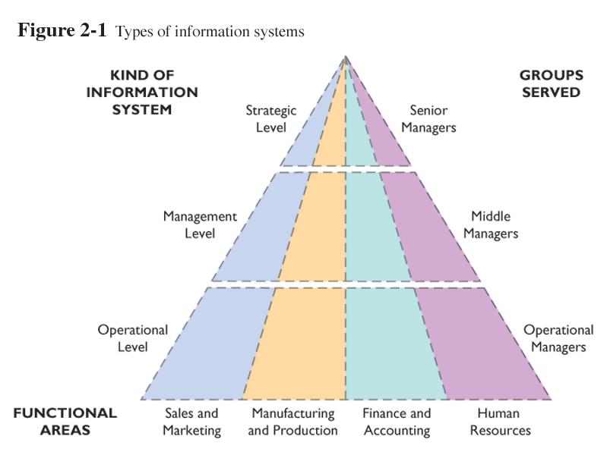
Major Types of Systems in Organizations
Types of information systems
Figure 2-1

Slide 6
Major Types of Systems in Organizations
Different Kinds of Systems
Three Main Categories of
Information Systems
Operational-level systems
Management-level systems
Strategic-level systems

Slide 7
Major Types of Systems in Organizations
Four Major Types of Systems
Transaction Processing Systems (TPS)
Management Information Systems (MIS)
Decision-Support Systems (DSS)
Executive-Support Systems (ESS)

Slide 8
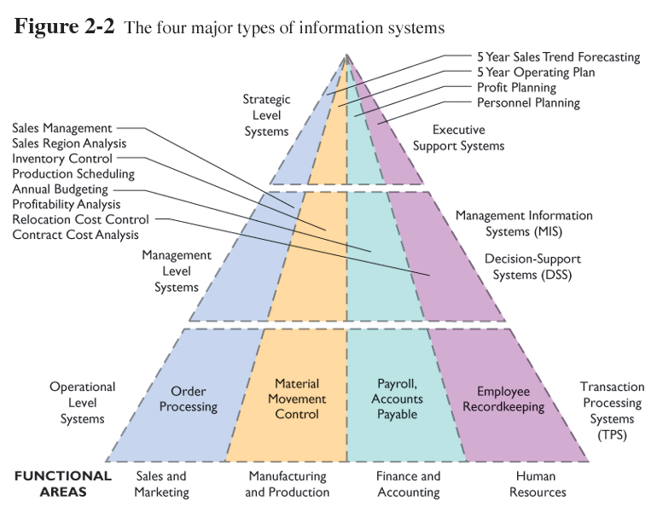
Major Types of Systems in Organizations
The four major types of information systems
Figure 2-2

Slide 9
Major Types of Systems in Organizations
Four Major Types of Systems
Transaction Processing Systems (TPS)
Basic business systems that serve the organization’s operational level
Input: Transactions, events
Processing: Sorting, listing, merging, updating
Output: Detailed reports, lists, summaries
Users: Operations personnel, supervisors

Slide 10
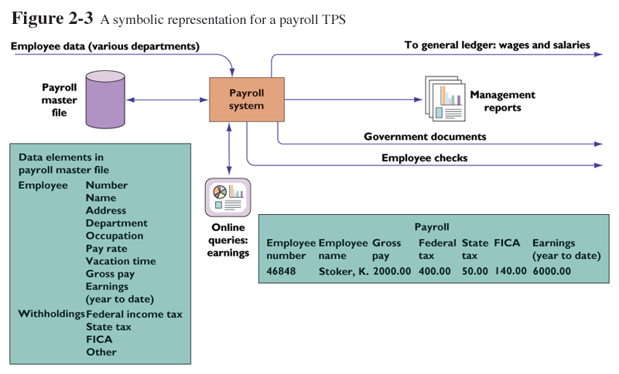
Major Types of Systems in Organizations
A symbolic representation for a payroll TPS
Figure 2-3

Slide 11
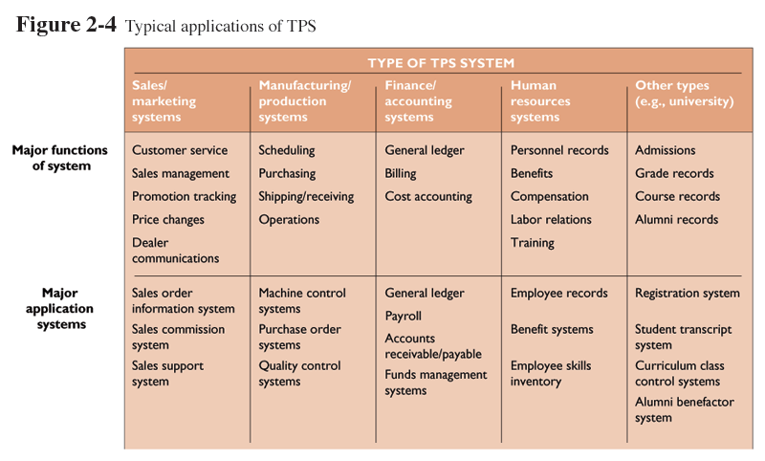
Major Types of Systems in Organizations
Typical applications of TPS
Figure 2-4

Slide 12
Major Types of Systems in Organizations
Four Major Types of Systems
Management Information Systems (MIS)
Serve management level; provide reports and access to company data
Input: Summary transaction data, high-volume data, simple models
Processing: Routine reports, simple models, low-level analysis
Output: Summary and exception reports
Users: Middle managers

Slide 13
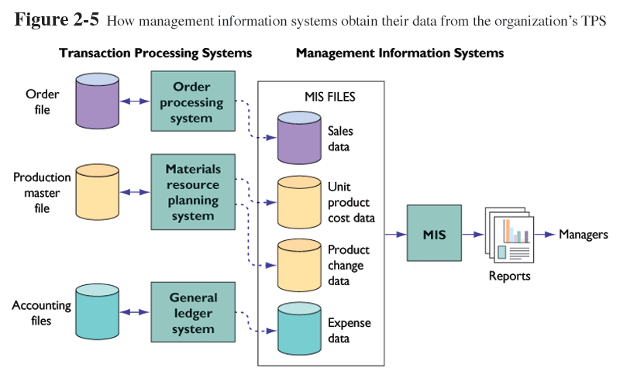
Major Types of Systems in Organizations
How management information systems obtain their data
from the organization’s TPS
Figure 2-5

Slide 14
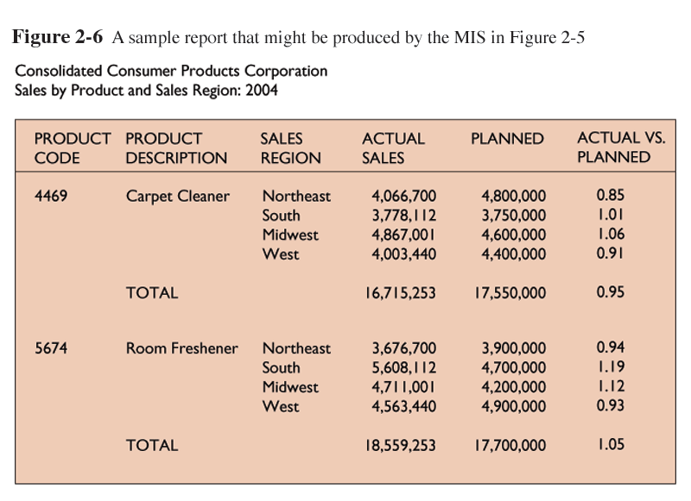
Major Types of Systems in Organizations
A sample report that might be produced by the MIS in Figure 2-5
Figure 2-6

Slide 15
Major Types of Systems in Organizations
Four Major Types of Systems
Decision-Support Systems (DSS)
Serve management level with data analysis for making decisions
Input: Low-volume data or massive databases, analytic models, and data analysis tools
Processing: Interactive, simulations, analysis
Output: Special reports, decision analyses, responses to queries
Users: Professionals, staff managers

Slide 16
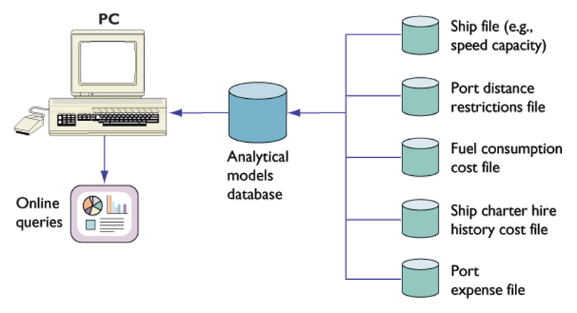
Major Types of Systems in Organizations
Voyage-estimating decision-support system
Figure 2-7

Slide 17
Major Types of Systems in Organizations
Four Major Types of Systems
Executive Support Systems (ESS)
Provide communications and computing environment that serves the organization’s strategic level
Input: External and internal aggregate data
Processing: Graphics, simulations, interactive
Output: Projections, responses to queries
Users: Senior Managers

Slide 18
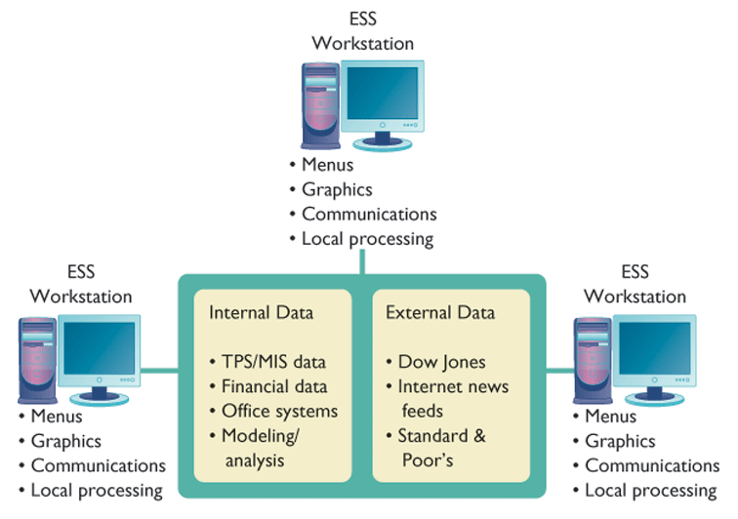
Major Types of Systems in Organizations
Model of a typical executive support system
Figure 2-8

Slide 19
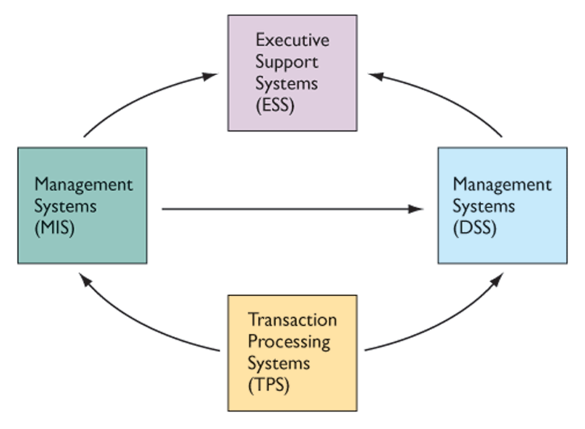
Major Types of Systems in Organizations
Interrelationships among systems
Figure 2-9

Slide 20
Systems from a Functional Perspective
Major Business Functions
Sales and Marketing Systems
Manufacturing and Production Systems
Finance and Accounting Systems
Human Resource Systems

Slide 21
Systems from a Functional Perspective
Sales and Marketing Systems
Help identify customers
Develop products and services
Promote products and services
Sell products and services
Provide ongoing customer support

Slide 22
Systems from a Functional Perspective
Table 2-2: Examples of Sales and Marketing Information Systems
System | Description | Organizational Level
Order processing | Enter, process, and track orders | Operational
Pricing analysis | Determine prices for products and services | Management
Sales trend forecasting | Prepare 5-year sales forecasts | Strategic

Slide 23
Systems from a Functional Perspective
Manufacturing and Production Systems
Planning, development, production of products and services
Planning, development, maintenance of production facilities
Acquisition, storage, availability of materials
Scheduling materials, facilities, labor
Controlling the flow of production

Slide 24
Systems from a Functional Perspective
Table 2-3: Examples of Manufacturing and Production Information Systems
System | Description | Organizational Level
Machine control | Control the actions of machines and equipment | Operational
Production planning | Decide when and how many products should be produced | Management
Facilities location | Decide where to locate new facilities | Strategic

Slide 25
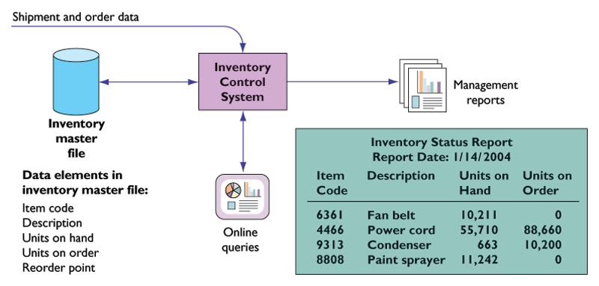
Systems from a Functional Perspective
Overview of an inventory system
Figure 2-10

Slide 26
Systems from a Functional Perspective
Finance and Accounting Systems
Manage firm’s financial assets: cash, stocks, bonds, etc.
Manage capitalization of firm and finding new financial assets
Maintain and manage financial records

Slide 27
Systems from a Functional Perspective
Table 2-4: Examples of Finance and Accounting Information Systems
System | Description | Organizational Level
Accounts receivable | Track money owed the firm | Operational
Budgeting | Prepare short-term budgets | Management
Profit planning | Plan long-term profits | Strategic

Slide 28
Systems from a Functional Perspective
Human Resources Systems
Identify potential employees
Maintain employee records
Track employee skills, job performance, and training
Support planning for employee compensation and career development

Slide 29
Systems from a Functional Perspective
Table 2-5: Examples of Human Resources Information Systems
System | Description | Organizational Level
Training and development | Track employee training, skills, and performance | Operational
Compensation analysis | Monitor wages, salaries, benefits | Management
Human resources planning | Plan long-term labor force needs | Strategic

Slide 30
Systems from a Functional Perspective
Window on Management
Employees Serve Themselves Online
What are the management benefits of employee self-service systems for human resources and benefits administration?
How do these systems provide value for businesses?
What management, organization, and technology issues should be addressed when installing self-service human resources and benefits systems?

Slide 31
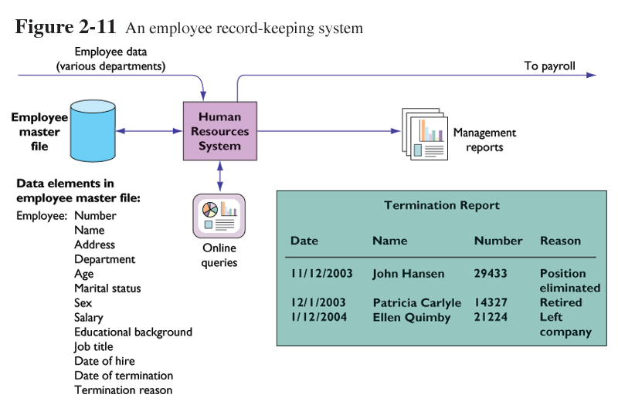
Systems from a Functional Perspective
An employee record-keeping system
Figure 2-11

Slide 32
Enterprise Applications
Business Processes and Information Systems
Business Processes
Manner in which work is organized, coordinated, and focused
Concrete workflows of material, information, and knowledge
Unique ways to coordinate work, information, and knowledge

Slide 33
Enterprise Applications
Business Processes and Information Systems
Examples of Functional Business Processes
Manufacturing and production: Assembling product, checking quality, producing bills of materials
Sales and marketing: Identifying customers, creating customer awareness, selling

Slide 34
Enterprise Applications
Business Processes and Information Systems
Examples of Functional Business Processes
Finance and accounting: Paying creditors, creating financial statements, managing cash accounts
Human Resources: Hiring employees, evaluating performance, enrolling employees in benefits plans

Slide 35
Enterprise Applications
Business Processes and Information Systems
Cross-Functional Business Processes
Transcend boundary between sales, marketing, manufacturing, and research and development
Group employees from different functional specialties to a complete piece of work
Example: Order Fulfillment Process

Slide 36
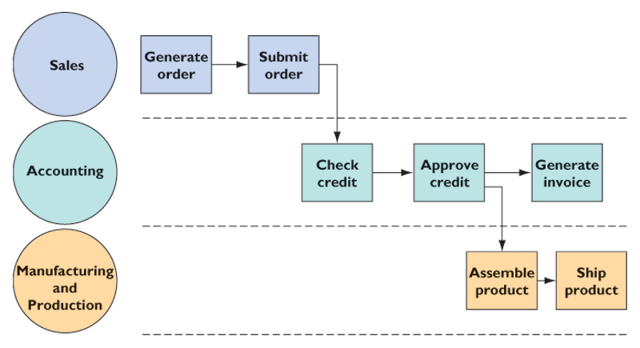
Enterprise Applications
The order fulfillment process
Figure 2-12

Slide 37
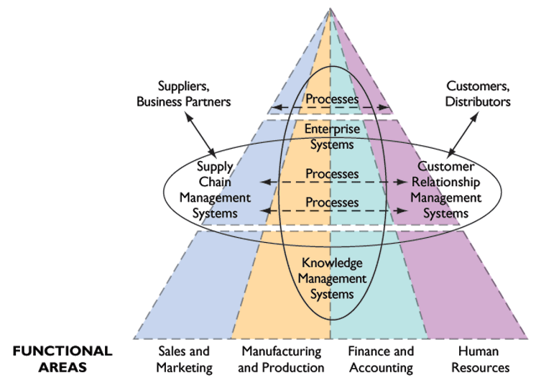
Enterprise Applications
Enterprise application architecture
Figure 2-13

Slide 38
Enterprise Applications
Business Processes and Information Systems
Enterprise Applications
Enterprise systems
Supply chain management systems
Customer relationship management systems
Knowledge management systems

Slide 39
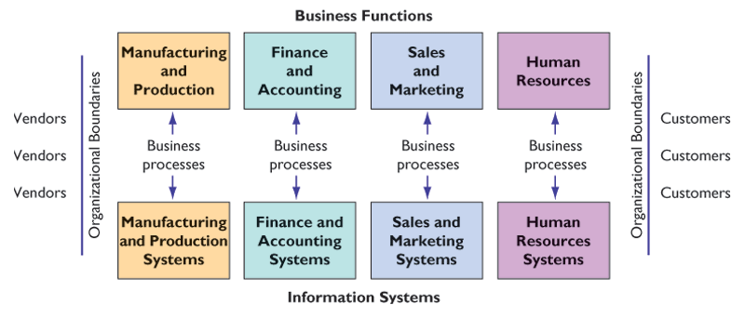
Enterprise Applications
Traditional view of systems
Figure 2-14

Slide 40
Enterprise Applications
Enterprise Systems
Enterprise resource planning (ERP)
Provides single information system for organization-wide coordination and integration of key business processes
Models and automates many business processes

Slide 41
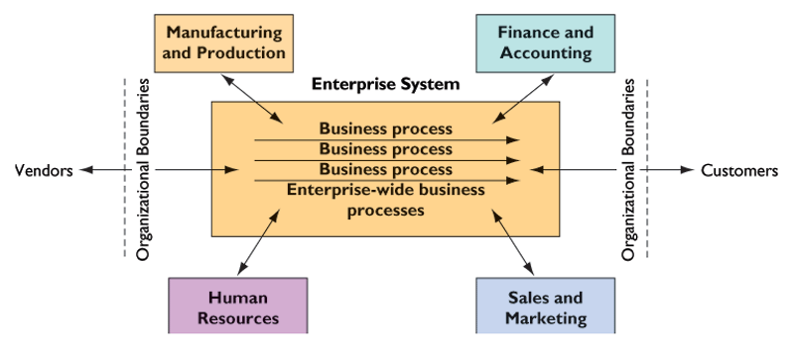
Enterprise Applications
Enterprise systems
Figure 2-15

Slide 42
Enterprise Applications
Supply Chain Management and Collaborative Commerce
Supply Chain Management Systems (SCM): Automate flow of information between firm and suppliers to optimize production and delivery
Supply Chain Management: Close linkage of activities involved in buying, making, moving a product
Supply Chain: Network of organizations and business processes for production and distribution of products

Slide 43
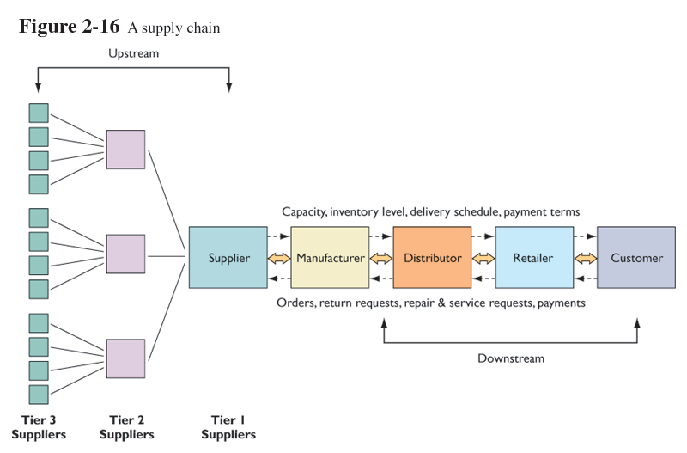
Enterprise Applications
A supply chain
Figure 2-16

Slide 44
Enterprise Applications
Supply Chain Management and Collaborative Commerce
Information Systems Can Help Supply Chain Participants:
Decide when and what to produce, store, and move
Rapidly communicate orders
Track status of orders
Check and monitor inventory
Reduce inventory, transportation, warehousing costs
Track shipments
Plan production based on actual customer demand
Rapidly communicate changes in product design

Slide 45
Enterprise Applications
Supply Chain Management and Collaborative Commerce
Collaborative Commerce
Uses digital technologies to enable multiple organizations to collaboratively design, develop, build, move, and manage products
Increases efficiencies in reducing product design life cycles, minimizing excess inventory, forecasting demand, and keeping partners and customers informed

Slide 46
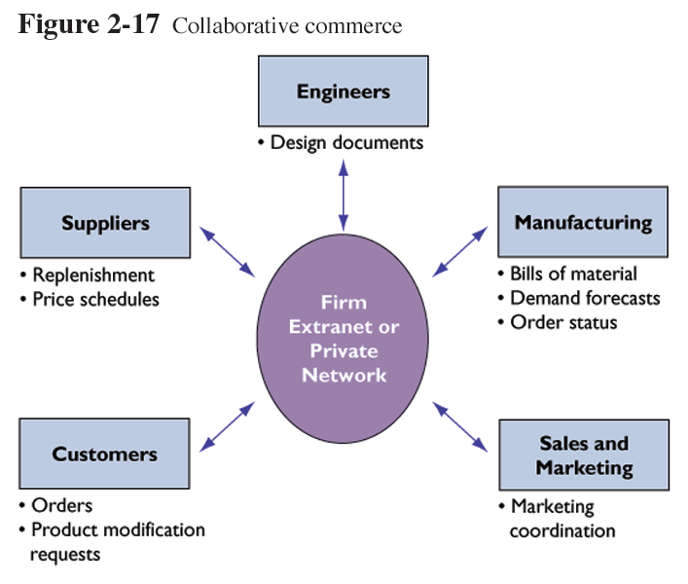
Enterprise Applications
Collaborative commerce
Figure 2-17

Slide 47
Enterprise Applications
Supply Chain Management and Collaborative Commerce
Collaborative planning, forecasting,
and replenishment (CPFR)
Collaboration between partners to formulate demand forecasts, develop production plans, coordinate shipping, warehousing, stocking
Private industrial networks
Web-enabled networks for coordinating transorganizational business processes

Slide 48
Enterprise Applications
Window on Technology
Diageo plc Collaborates in Real-Time
What are the business benefits of using CPFR?
How does Diageo’s system for CPFR provide value for the company and for its suppliers and distributors?

Slide 49
Enterprise Applications
Supply Chain Management and Collaborative Commerce
How Businesses Engage in
Collaborative Commerce
Product design and development
Service and support
Supply chain coordination
Logistics
Sales support and training
Channel management

Slide 50
Enterprise Applications
Customer Relationship Management (CRM)
Manages ways used to deal with existing and potential customers
Both a business and technology discipline
Uses information systems to coordinate all customer interaction processes in sales, marketing, and service.

Slide 51
Enterprise Applications
Customer Relationship Management (CRM)
Customer Relationship Management Systems
Track all customer interactions
Analyze data to optimize revenue, profitability, customer satisfaction, customer retention

Slide 52
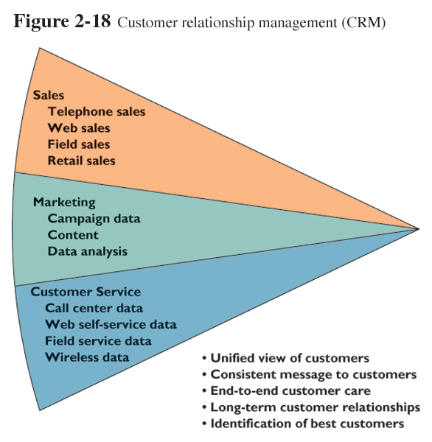
Enterprise Applications
Customer Relationship Management (CRM)
Figure 2-18

Slide 53
Enterprise Applications
Knowledge Management Systems in the Enterprise
Knowledge Management Systems (KMS)
Collect relevant knowledge and experience in firm to support business processes and management decisions
Manage and distribute documents and other digital knowledge objects

Slide 54
Enterprise Applications
Knowledge Management Systems in the Enterprise
Role of Knowledge Management Systems
Acquire knowledge
Store knowledge
Distribute knowledge
Apply knowledge

Slide 55
International Information Systems
Forms of Global Business Organization
Four Main Ways of Organizing
Businesses Internationally
Domestic exporter
Multinational
Franchiser
Transnational

Slide 56
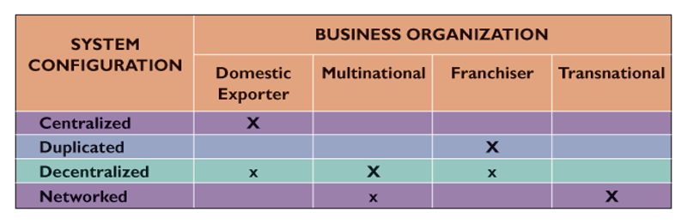
International Information Systems
Global business organization and systems configurations
Figure 2-19

Slide 57
Chapter 2 Case Study
Can Zara Keep Up with Speed Chic?
Summarize Zara’s current competitive situation.
How are information systems related to the way Zara runs its business?
How do Zara’s information systems provide value to the company?

Slide 58
Chapter 2 Case Study
Can Zara Keep Up with Speed Chic?
Identify the management, organization, and technology issues that affect the future of this company.
Does Zara have a viable business model? Why or why not?

